Slide 1

Smart Labs
By
Karan Saji Vethody (22106023)
Suraj Vishwakarma (22106019)
Disha Waghmare (220106033)
Shikshita Yadav (22106092)
Project Guide
Dr. Jaya Gupta

Slide 2
Outline
Introduction
Literature Survey of the existing systems
Limitations of the existing systems
Problem statement
System Design
Technologies and methodologies
Implementation
Conclusion
References

Slide 3
Introduction
Intelligent Research Environment: Smart Labs leverage IoT, AI, and automation to enhance efficiency and adaptability.
Smart Lighting & Automation: Automated switches and lighting systems adjust based on occupancy and natural light levels.
Enhanced Safety Measures: Advanced monitoring and automation improve lab security and operational safety.
Support for Scientific Innovation: A cutting-edge environment fosters groundbreaking research and global problem-solving.
Environmental Monitoring: Sensors track environmental factors to maintain optimal conditions.

Slide 4
Motivation:
Enhance the efficiency and automation of laboratory operations.
Ensure optimal energy utilization through intelligent lighting and appliance control.
Leverage IoT and AI for real-time monitoring and adaptive environmental control.
Improve safety by integrating smart sensors for fire, gas leaks, and environmental hazards.
Facilitate a data-driven approach for better resource management and sustainability.
Objective:
Develop an IoT-based smart lab system for automated control of lighting, fans, and other appliances.
Implement sensors to monitor occupancy, temperature, and environmental conditions.
Reduce energy consumption and operational costs through automation.
Improve user experience by providing a seamless and adaptive laboratory environment.
Integrate cloud-based monitoring and analytics for real-time data insights and decision-making.

Slide 5
Literature Survey of the existing system
Research Paper | Summary | Limitations | Adaptions
Automation of Room Lighting System Using Arduino and PIR Sensor(2022) | P. Rajakumar et al. review automated lighting system using Arduino and PIR sensors to detect motion and control lighting. Helps in reducing electricity wastage by ensuring lights operate only when needed. | Limited detection range of PIR sensors, does not detect static presence, causing unintended light turn-off. | The study suggests that implementing such automated systems can significantly reduce electricity wastage by ensuring lights are only on when needed.
Internet of Things Environment Automation: A Smart Lab Practical Approach(2022) | It reviews an automation platform aimed at applications in Smart Labs. It allows for automating air conditioning setups, internal lighting and door access. | High initial setup cost for IoT integration. Security vulnerabilities due to cloud-based data exchange. | The integration of IoT with WSNs offers a comprehensive solution for remote monitoring and control, potentially applicable to various research and industrial settings

Slide 6
Research Paper | Summary | Limitations | Adaptions
Smart-Lab: Design and Implementation of an IoT-based Laboratory Platform(2022) | It reviews developing an IoT-integrated Smart-Lab for remote surveillance and control which uses Wireless Sensor Networks to automate lab activities. | Requires stable internet connectivity for efficient operation. Potential security risks due to IoT and cloud-based data transmission. | The integration of IoT with WSNs offers a comprehensive solution for remote monitoring and control.
Integrated IoT Devices in the Improvement of the Industrial Lab Experience(2020) | Armin Kobilica et al. reviews IoT integration to improve lab monitoring and control. | Network Dependency as requires stable internet for optimal performance. Security Risks since vulnerable to cyber threats and data breaches. | The integration of IoT devices is suggested to improve monitoring and control within industrial labs.
Smart-building management system: An Internet-of-Things (IoT) application business model in Vietnam(2019) | It reviews an IoT-based smart-building management system focusing on energy efficiency that proposes a business model for smart buildings in Vietnam. | Expensive initial setup & maintenance. Technical Challenges that requires skilled personnel for operation and troubleshooting. | Improves energy efficiency and system integration in buildings. Can be used as a framework for smart cities development.

Slide 7
Limitations of Existing Systems
High Initial Cost: Setting up sensors, microcontrollers, and automation systems can be expensive.
Dependency on Power & Internet: Many smart systems rely on electricity and internet connectivity, making them vulnerable to outages.
Sensor Accuracy Issues: Motion or presence sensors may sometimes fail to detect people correctly, leading to false triggers.
Compatibility Challenges: Integrating different smart devices and platforms can be complex.
Limited Manual Control: In case of system failure, manual operation might be required, causing inconvenience.

Slide 8
Problem statement
Traditional lighting systems in college laboratories result in excessive energy consumption due to manual operation and lack of adaptive control. Lights often remain on even when not needed, leading to increased electricity costs and a larger environmental footprint. To address this issue, an intelligent lighting system using Arduino, PIR sensors, and microwave radar sensors is required. However, challenges such as managing sensor sensitivity, optimizing detection range, and ensuring seamless automation must be overcome to achieve efficient energy conservation and a comfortable learning environment.

Slide 9
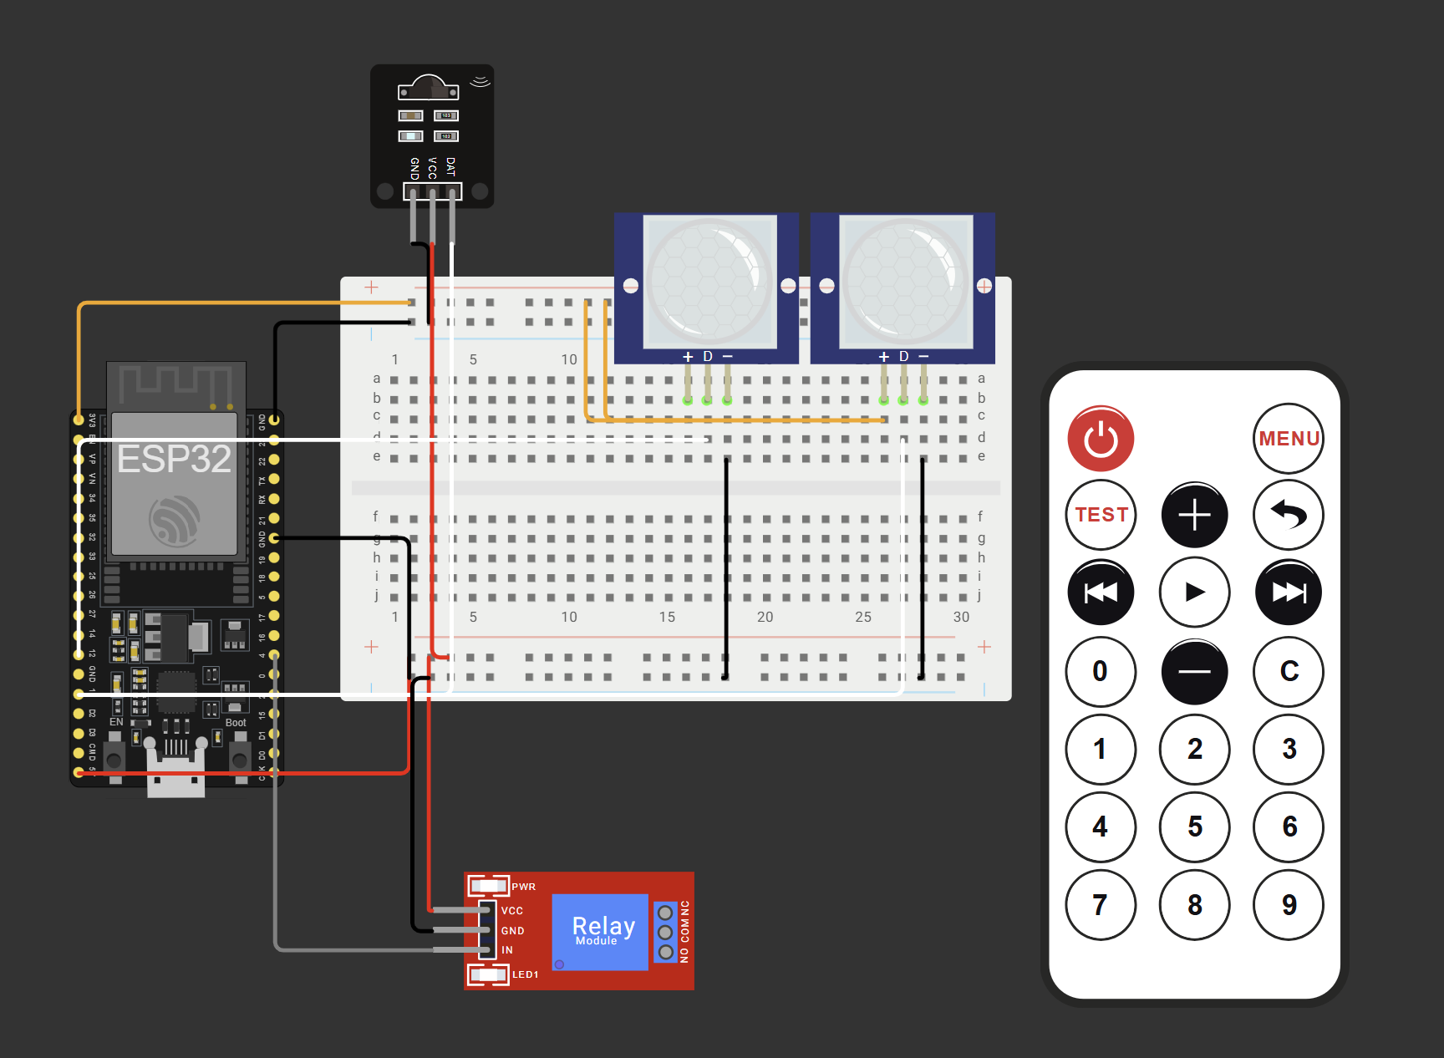
System Design

Slide 10
Technologies and methodologies
Hardware Used:
ESP32-D
Development Board
Relay Module
Microwave Radar Sensor
Mini PIR Sensor
IR Sensor
9v Power Supply
Resistors
Breadboard
Wires
Software Used:
Arduino IDE
Wokwi Simulation

Slide 11
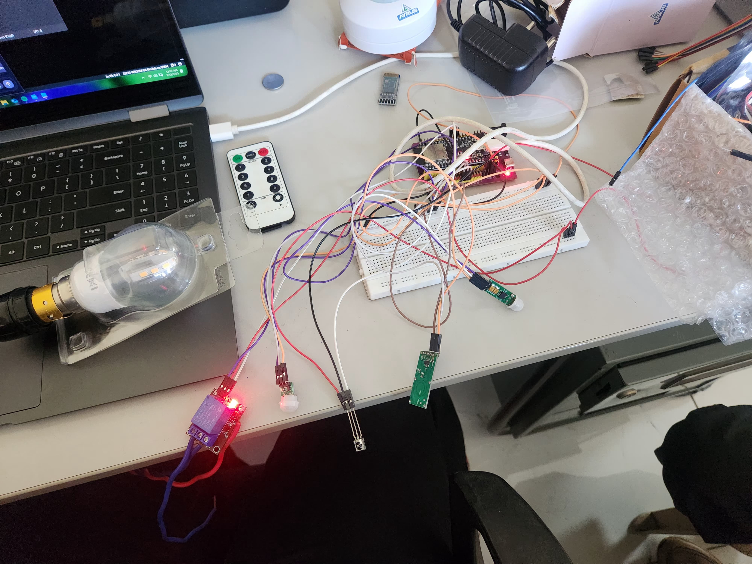
Implementation

Slide 12
Conclusion
Energy Conservation: The automated lighting system reduces unnecessary power usage by ensuring lights are only activated when needed.
Cost Efficiency: Minimizes electricity bills and operational costs by optimizing energy consumption.
Enhanced User Experience: Provides a seamless and intelligent lighting solution, eliminating the need for manual control.
IoT and Automation Integration: Demonstrates the potential of combining IoT, motion sensors, and light sensors to create smart lab environments.
Future Innovations: Lays the foundation for further advancements in smart lab design and automation technologies.

Slide 13
References
[1] P. Rajakumar, Barath C. Kanna, R. Archana, A. Akshaya, K Abhinaya, M. Boobalan, “Automation of Room Lighting System Using Arduino and PIR Sensor”, IEEE, December 2022
[2] A. C. de Melo, R. C. G. de Sousa, and J. C. de Oliveira, “Internet of Things Environment Automation: A Smart Lab Practical Approach”, IEEE, 2022
[3] M. S. Hossain, M. Fotouhi, R. Hasan, N. A. Mahmud, M. A. Hossain, and N. N. N. Mahmud, “Smart-Lab: Design and Implementation of an IoT-based Laboratory Platform”, IEEE, 2020
[4] Armin Kobilica, Muhammad Izzuddin Al Fikri, Farag Ahmed Azzedin, Tarek Rahil Sheltami, Luai M. Alhems, “The Perspectives of the Integrated IoT Devices in the Improvement of the Industrial Lab Experience”, IEEE, 2020
[5] D. N. Le, L. Le Tuan and M. N. D. Tuan, "Smart-building management system: An internet-of-things (IoT) application business model in vietnam", vol. 141, pp. 22-35, 2019.

Slide 14
Thank You...!!

